Slide 1
Static Equilibrium Lab

Slide 2
Questions
What is torque?
What factors does torque depend on and how?
What does it mean for an extended object to be in equilibrium?
How to analyze an extended object in equilibrium?

Slide 3
Activities
Activity 1: getting a feel for torque
Activity 2: The Seesaw

Slide 4
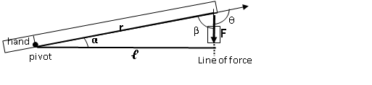
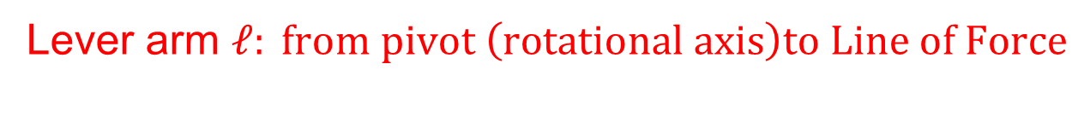
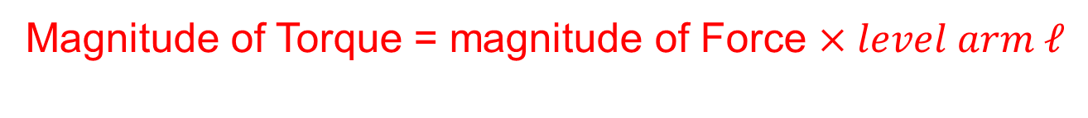
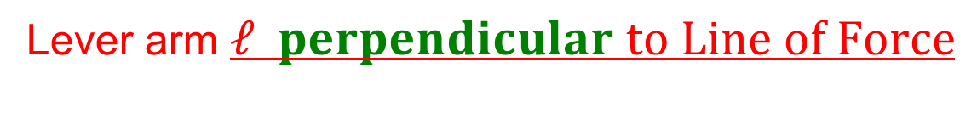
Activity 1
Lever arm
Lever arm $ℓ: from pivot \left(rotational axis\right)to Line of Force$
Lever arm $ℓ perpendicular to Line of Force$
Magnitude of Torque = magnitude of Force $×level arm ℓ$

Slide 5
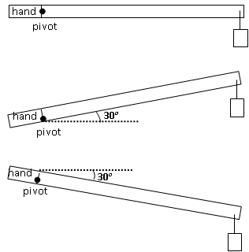
Activity 1
10cm
90cm
Lever arm
0.1kg
90cm
10cm
0.1kg
Lever arm
Lever arm
10cm
90cm
0.1kg

Slide 6
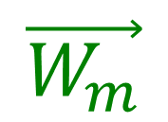
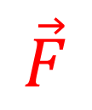
Activity 2 prep
Spring scale force meter
$$\vec{F}$$
$$\vec{W_{m}}$$
Weight of the meter-stick
Hang the meter stick through the hole at the center (without any additional item). Check the balance of the meterstick.
If the balance is off, put a metal clamp on the meter stick to achieve the balance. This metal clamp becomes an intrinsic part of the meter stick. (The "weight of the meter stick" should be = weight of meter stick itself + weight of clamp)

Slide 7
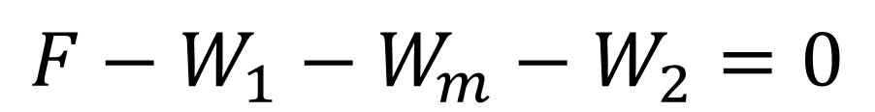
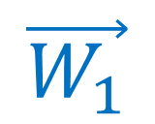
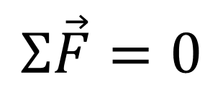

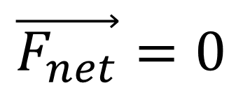
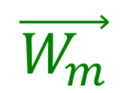
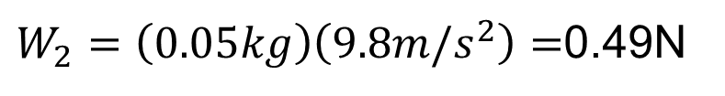
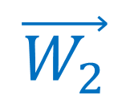
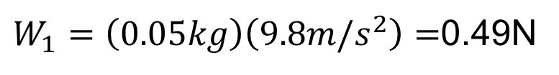
Activity 2 Part A
Spring scale force meter
+
$$\vec{F}$$
$$\vec{W_{1}}$$
$$\vec{W_{m}}$$
$$\vec{W_{2}}$$
Hanging weight 1
Weight of the meter-stick
Hanging weight 2
$$\vec{F_{net}}=0$$
In Equilibrium: Newton’s Second Law
$$Σ\vec{F}=0$$
$$F−W_{1}−W_{m}−W_{2}=0$$
$W_{1}=\left(0.05kg\right)\left(9.8m/s^{2}\right)=$0.49N
$W_{2}=\left(0.05kg\right)\left(9.8m/s^{2}\right)=$0.49N

Slide 8

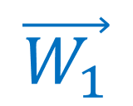
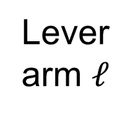
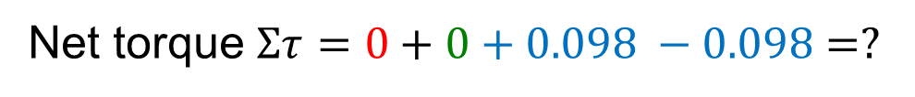


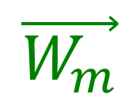

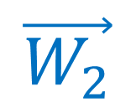

Activity 2 Part A (continued)
Spring scale force meter
$$\vec{F}$$
rotational axis (pivot point)
Hanging weight 1
$$\vec{W_{1}}$$
$$\vec{W_{m}}$$
$$\vec{W_{2}}$$
Hanging weight 2
Weight of the meter-stick
Choose the center hole as the rotational axis:
Lever arm $ℓ$is measured from the rotational axis
Force magnitude
Lever arm $ℓ$
Torque magnitude
Torque orientation
Sign of Torque
Force
Torque
$$\vec{F}$$
0
0
$$\vec{W_{m}}$$
0
0
$$\vec{W_{1}}$$
0.49N
0.2m
(0.49)(0.2) = 0.098 Nm
CCW
+
+0.098Nm
$$\vec{W_{2}}$$
- 0.098Nm
0.49N
0.2m
(0.49)(0.2) = 0.098 Nm
CW
-
Net torque $Στ=0+0+0.098 −0.098=?$

Slide 9
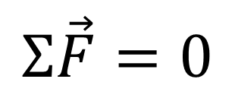
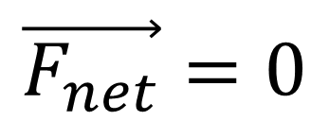

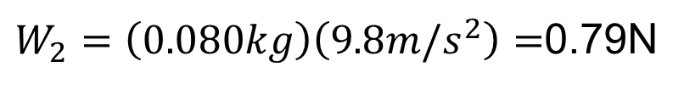
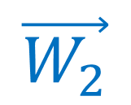
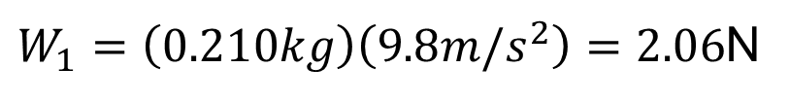
Activity 2 Part B
Spring scale force meter
+
$$\vec{F}$$
$$\vec{W_{1}}$$
$$\vec{W_{m}}$$
$$\vec{W_{2}}$$
Hanging weight 1
(parent)
Weight of the meter-stick
Hanging weight 2
(child)
$$\vec{F_{net}}=0$$
In Equilibrium: Newton’s Second Law
$$F−W_{1}−W_{m}−W_{2}=0$$
$$Σ\vec{F}=0$$
$W_{1}=\left(0.210kg\right)\left(9.8m/s^{2}\right)=2.06$N
$W_{2}=\left(0.080kg\right)\left(9.8m/s^{2}\right)=$0.79N

Slide 10
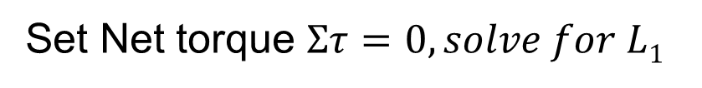
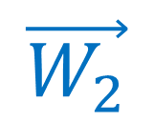
Activity 2 Part B (continued)
Spring scale force meter
$$\vec{F}$$
rotational axis (pivot point)
L1
L2 =0.4m
Hanging weight 1 (parent)
$$\vec{W_{m}}$$
$$\vec{W_{2}}$$
$$\vec{W_{1}}$$
Hanging weight 2 (child)
Weight of the meter-stick
Choose the center hole as the rotational axis:
Lever arm $ℓ$is measured from the rotational axis
Force magnitude
Lever arm $ℓ$
Torque magnitude
Torque orientation
Sign of Torque
Force
Torque
$$\vec{F}$$
$$\vec{W_{m}}$$
$$\vec{W_{1}}$$
2.06N
$$\vec{W_{2}}$$
0.79N
Set Net torque $Στ=0, solve for L1$

Slide 11
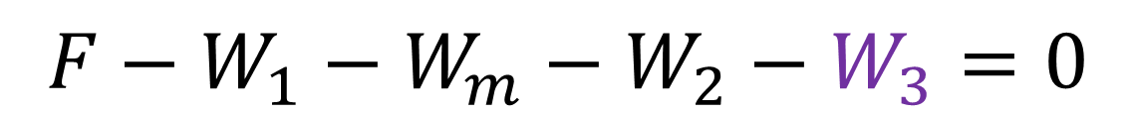
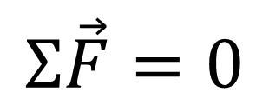
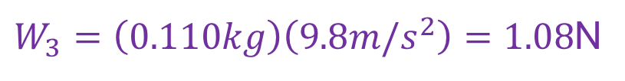
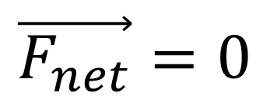
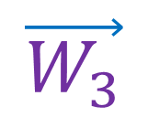
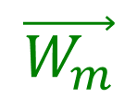
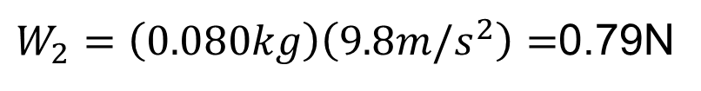

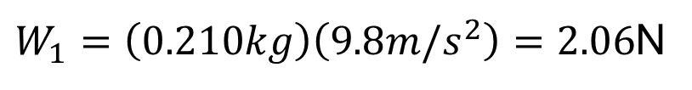
Activity 2 Part C
Spring scale force meter
+
$$\vec{F}$$
$$\vec{W_{1}}$$
$$\vec{W_{m}}$$
$$\vec{W_{2}}$$
Weight of the meter-stick
$$\vec{W_{3}}$$
Hanging weight 2
(child 1)
Hanging weight 1
(parent)
Hanging weight 3
(child 2)
$$\vec{F_{net}}=0$$
In Equilibrium: Newton’s Second Law
$$F−W_{1}−W_{m}−W_{2}−W_{3}=0$$
$$Σ\vec{F}=0$$
$W_{1}=\left(0.210kg\right)\left(9.8m/s^{2}\right)=2.06$N
$W_{2}=\left(0.080kg\right)\left(9.8m/s^{2}\right)=$0.79N
$W_{3}=\left(0.110kg\right)\left(9.8m/s^{2}\right)=1.08$N

Slide 12



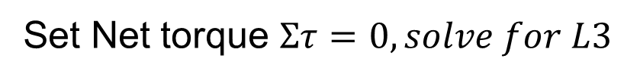






Activity 2 Part C (continued)
Spring scale force meter
$$\vec{F}$$
rotational axis (pivot point)
L1=0.3m
L2 =0.4m
Hanging weight 1 (parent)
$$\vec{W_{2}}$$
$$\vec{W_{1}}$$
$$\vec{W_{m}}$$
L3
Hanging weight 2 (child 1)
$$\vec{W_{3}}$$
Weight of the meter-stick
Hanging weight 3 (child 2)
Choose the center hole as the rotational axis:
Lever arm $ℓ$is measured from the rotational axis
Force magnitude
Lever arm $ℓ$
Torque magnitude
Torque orientation
Sign of Torque
Force
Torque
$$\vec{F}$$
$$\vec{W_{m}}$$
$$\vec{W_{1}}$$
2.06N
$$\vec{W_{2}}$$
0.79N
$$\vec{W_{3}}$$
1.08N
Set Net torque $Στ=0, solve for L3$

Slide 13

Activity 2 Part D (your design)
Spring scale force meter
+
$$\vec{F}$$
$$\vec{W_{1}}$$
$$\vec{W_{m}}$$
$$\vec{W_{2}}$$
Hanging weight 1
(parent)
Weight of the meter-stick
Hanging weight 2
(child)
$$\vec{F_{net}}=0$$
In Equilibrium: Newton’s Second Law
$$F−W_{1}−W_{m}−W_{2}=0$$
$$Σ\vec{F}=0$$
W1 (your own)
$$W_{2} will be determined$$

Slide 14
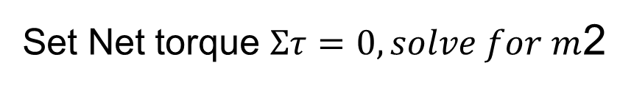
Activity 2 Part D (continued) your design
Spring scale force meter
$$\vec{F}$$
rotational axis (pivot point)
L1
L2
Hanging weight 1 (parent)
$$\vec{W_{m}}$$
$$\vec{W_{2}}$$
$$\vec{W_{1}}$$
Hanging weight 2 (child)
Weight of the meter-stick
Choose the center hole as the rotational axis:
Lever arm $ℓ$is measured from the rotational axis
Force magnitude
Lever arm $ℓ$
Torque magnitude
Torque orientation
Sign of Torque
Force
Torque
$$\vec{F}$$
$$\vec{W_{m}}$$
$$\vec{W_{1}}$$
Your own
L1 (your own)
$$\vec{W_{2}}$$
Will be determined
L2 (your own)
Set Net torque $Στ=0, solve for m$2

